Slide 1
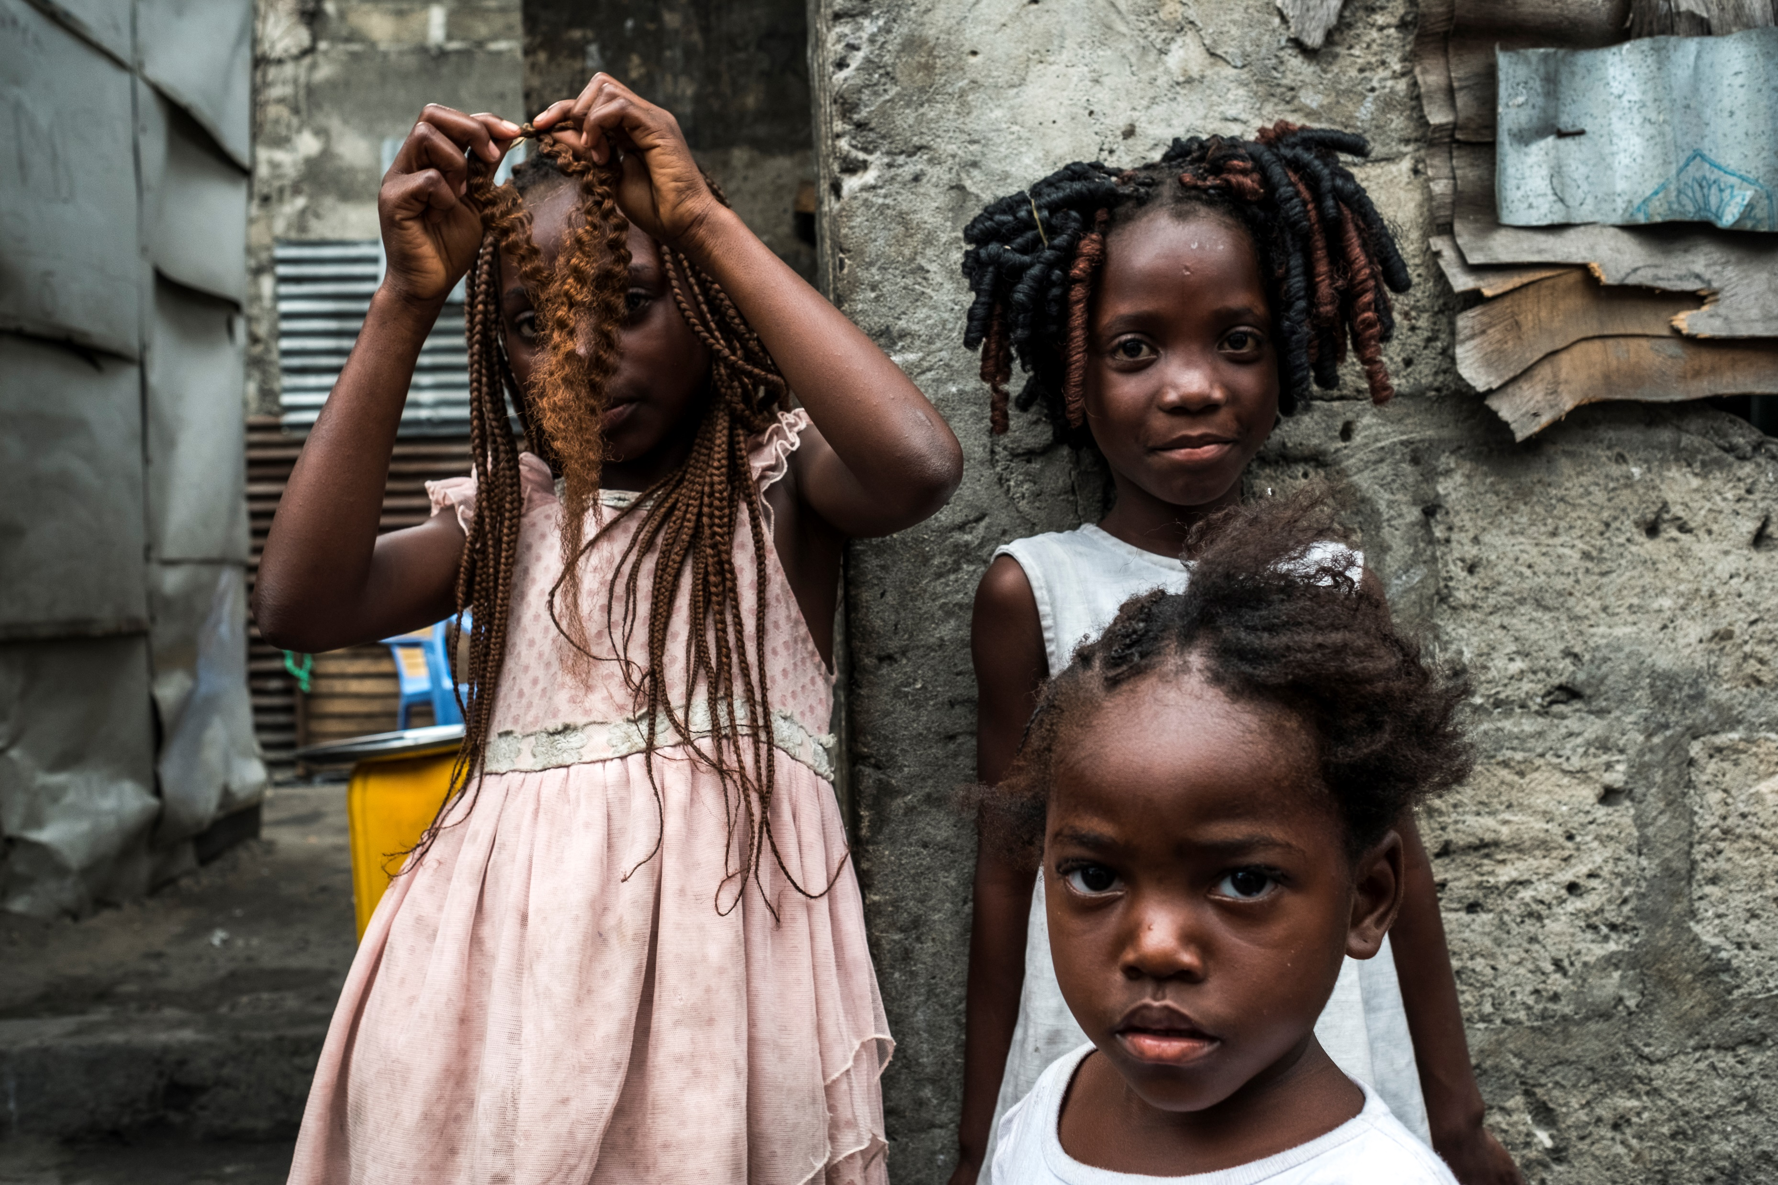
Opportunities for the use of new ARVs for infants, children and adolescents and updated guidance on early infant diagnosis
Martina Penazzato MD, PhD
Paediatric lead, HIV Department
World Health Organization, Geneva

Slide 2
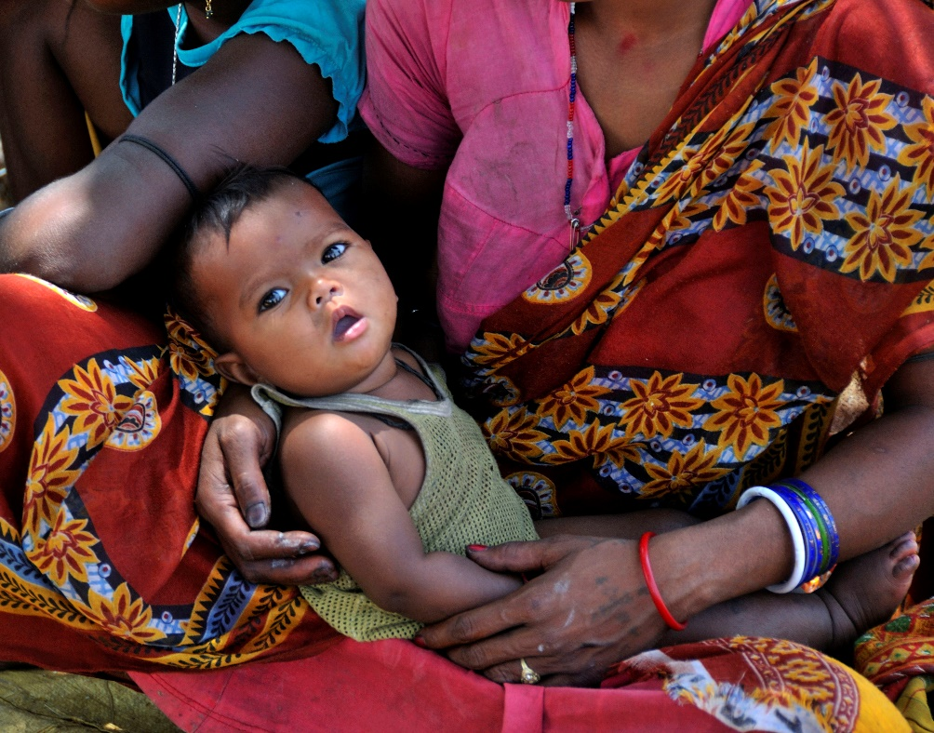
Background
1.8 million children were estimated to live with HIV in 2017
In 2017, only 51 % of HIV-exposed infants received EID (by 2mo)
Increasing exposure to maternal ARVs offers new challenges to ensure accurate EID
Treatment coverage remains poor with only 52% receiving ART
Almost half of those on ART continue to receive NVP based regimens
HIVDR to NNRTI is as high as 60% as demonstrated by multiple national surveys
Virological suppression remains poor particularly in younger children
Lack of potent, tolerable ARVs in age appropriate formulations remains a critical barrier to scale up of paediatric treatment globally
Introduction of new ARVs can happen when proven to be effective in adult population as soon as safety and PK are available to inform dosing.
Notes:
Emerging cnsensus

Slide 3
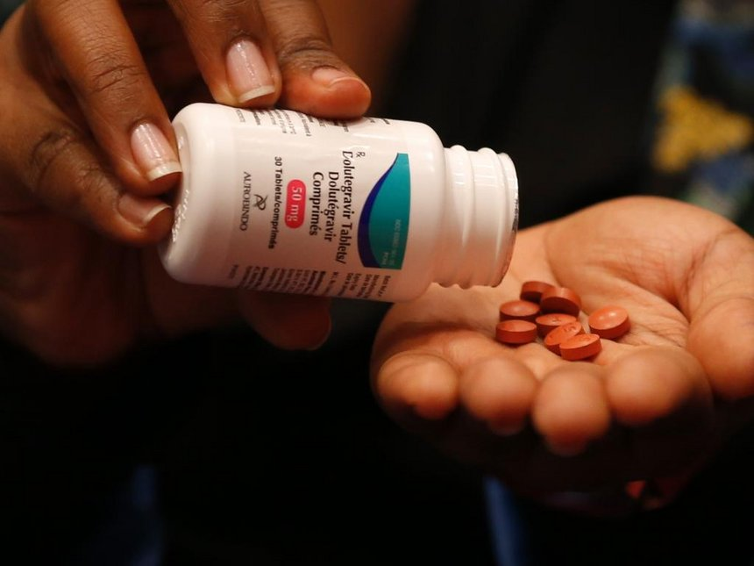
Considerations for use of DTG
Extrapolation from adult efficacy data¹
Safety and PK from P1093² and ODYSSEY³
Some limited experience in clinical practice from CHIPS cohort⁴
High genetic barrier integrase inhibitor
Acceptability of once daily administration
Feasibility in the context of simplified dosing
Need for clarity on dosing during TB cotreatment
Approved dosing below 15 kg to become available in late 2019
Need for strengthening of toxicity monitoring alongside introduction
References:
1. Kanters et al 2018; 2. Viani et al 2015, Wiznia et al 2016, Ruel et al 2017; 3. Turkova et al 2018; 4 Collins et al 2018; 5. Archary

Slide 4
Considerations for use of RAL
Extrapolation from adult efficacy data¹
Safety and PK from birth based on P1066 and P1110 trials²
Dosing for TB cotreatment available from P1101 trial³
Limited experience with use in first line for young children⁴
Low genetic barrier compared to DTG with potential selection of INSTI resistance (BD DTG following use of RAL)
Feasibility and acceptability of granules⁵
Recommendation for use of time-limited provision while possible is not desirable for procurement and supply⁶
Need to provide a non NNRTI alternative for neonates and for settings where LPVr pellets might not be available
References:
1. Kanters et al 2018; 2. Nachman et al 2014, Clarke et al. 2017; 3. Meyers et al 2018; 4. Personal communication IeDea/CIPHER; 5. Archary et al 2018; 6. APWG 2018.

Slide 5
Overall messages
Move away from NNRTI-based regimens
Introduce DTG as soon as possible
Use the most potent non-NNRTI option

Slide 6
WHO 2018 recommendations for 1st line
 | NEONATES | CHILDREN
Preferred | AZT+3TC+RAL¹ | ABC+3TC+DTG²
Alternatives | AZT+3TC+NVP | ABC+3TC+LPV/r ABC+3TC+RAL²
Special circumstances⁴ | AZT+3TC+LPV/r | ABC (or AZT)+3TC+EFV³ ABC (or AZT)+3TC+RAL AZT+3TC+LPV/r AZT+3TC+RAL AZT+3TC+NVP
In children older than 6 years and weighting at least 15 kg
Simplified dosing approach allows for use of 50 mg adult tablet from 25 kg
¹ For the shortest time possible, until a solid formulation of LPV/r or DTG can be used
² For age and weight groups with DTG approved dosing and where LPV/r is not available
³ In cases where no other alternatives are available
⁴ From 3 years of age

Slide 7
WHO 2018 recommendations for 2nd and 3rd line
Population | 1st line | 2nd line | 3rd line
Children | 2 NRTI + LPV/r | 2 NRTIs + DTG** | DRV/r + DTG**** ± 1-2 NRTIs Where possible consider optimization using genotyping
 | 2 NRTIs + EFV | 2 NRTIs + DTG***
 | 2 NRTI + DTG | 2 NRTIs + (ATV/r or LPV/r)
* Optimized NRTI backbone should be used: AZT following TDF or ABC failure, and viceversa.
**This applies to children for whom approved DTG dosing is available. RAL should remain the preferred 2nd line for those children for whom approved DTG is not available
***This applies to children for whom approved DTG dosing is available. ATV/r or LPV/r should remain the preferred 2nd line for those children for whom approved DTG is not available.
****DTG based 3rd line following use of INSTI must be administered with DTG BD.

Slide 8
From a sequential to a parallel approach
Registrational trial
Dosing
Safety
Strategic trial
Efficacy
Simplified dosing
Guidelines introduction
Age specific recommendations
TB cotreatment
WHO weight band dosing
2011
Dolutegravir
2021
P1093
DTG dosing and safety
4 weeks to 18 years in 5 cohorts
Coated tablets, granules and 5mg dispersible tablets
ODYSSEY
Enrolment of subjects following the first 1093 cohorts
PK sub-studies to inform dose simplification
TB PK to investigate DTG BD plus Rifampicin
Guidelines Update
Extrapolated efficacy from adults
Safety and PK based on P1093
Simplified dosing based on ODYSSEY
Overarching rolling recommendation
2018
This may allow access to DTG for children 3 years earlier with potentially 500 000 more children on a more effective regimen
Notes:
Cohort I: Adolescents ≥12 to <18 years of age (Tablet formulation)
Cohort IIA: Children ≥6 to <12 years of age (Tablet formulation)
Cohort IIB: Children ≥6 to <12 years of age (Granules)
Cohort III - DT: Children ≥2 to <6 years of age (Dispersible Tablet)
Cohort IV - DT: Children ≥6 months to <2 years (Dispersible Tablet)
Cohort V - DT: Infants ≥4 weeks to <6 months (Dispersible Tablet)

Slide 9
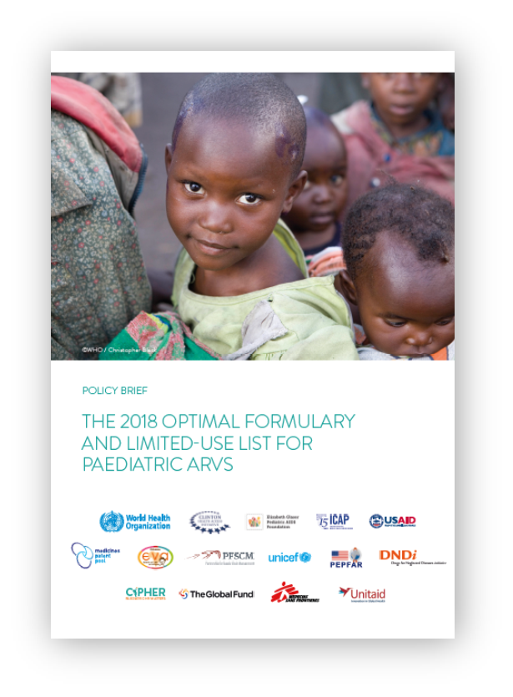
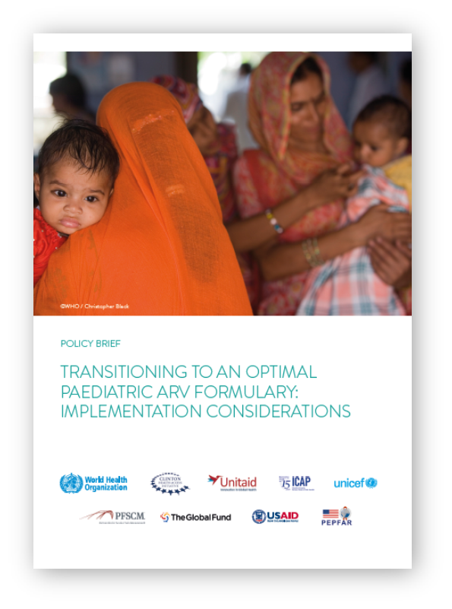
Support for implementation
Guiding product selection in line with Global Guidelines
Supporting transition to optimal regimens
Soon available online at http://www.who.int/hiv/pub/paediatric/aids-free-toolkit/en/

Slide 10
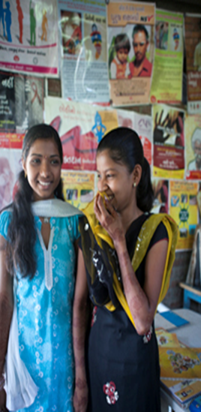
Implementation considerations for adolescents
DTG is of particular benefit to adolescents (sub-optimal adherence, EFV side-effects, triple class failure).
In LMIC, half of the estimated 23 million pregnancies in adolescent girls (2 million in below 15 years) were unintended.
Policy decisions on DTG are an opportunity to review access SRHR services and current status of their integration with HIV services.
Ensuring that adolescent girls living with HIV are well informed of their options to prevent unintended pregnancies, and provided with pre-pregnancy care to avoid use of DTG during preconception.
A differentiated approach for integrated adolescent-friendly services is needed together with direct involvement of adolescents.
Notes:
Among adolescents girls An estimated 15% of the 252 million adolescent women aged 15–19 years are sexually active
In view of the gradual shift to non-facility-based service delivery models, community networks and community health workers need to provide HIV and sexual and reproductive health services using an adolescent-friendly approach.
Programmes should engage and involve adolescents, directly and through health worker and community-based approaches, to improve the understanding of contraceptive methods and sexual and reproductive health and how this relates to the DTG safety concern.

Slide 11
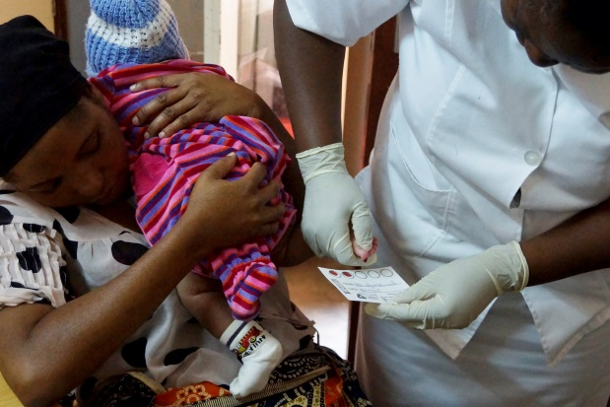
Timely ART initiation upon accurate EID
WHO Infant testing algorithm
20% MTCT
Positive HIV NAT
x 400
Infant is HIV infected
True positive
1% MTCT
Immediate START ART
Repeat NAT to confirm HIV infection
False positive
True negative
Start ART, without delay and new specimen collected at the time of ART initiation
x 9,900
Confirmatory NAT is poorly implemented: how do we minimize unnecessary ART?

Slide 12
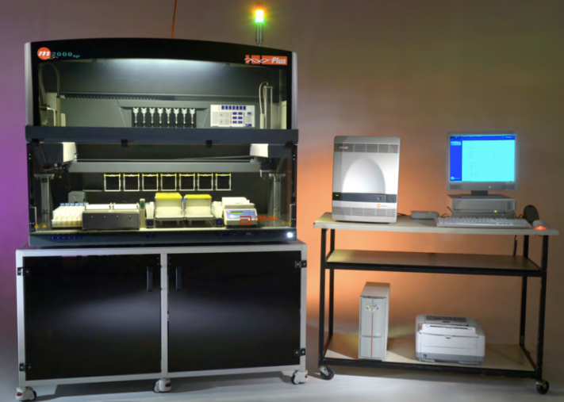
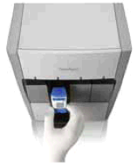
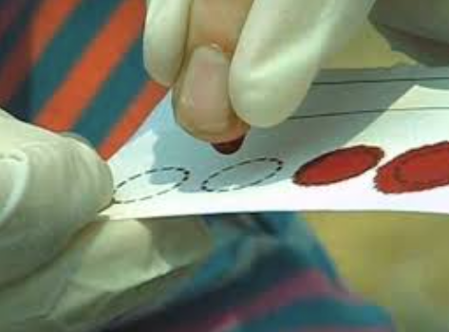
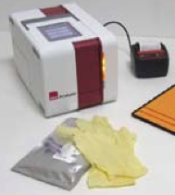
Acting at the laboratory
Qualitative technologies generally report ‘detected’ or ‘not detected’, which is interpreted as ‘positive’ or ‘negative’, respectively.
HOWEVER
Low levels of viremia may not be due to infection but rather contamination at the point of collection or at the laboratory.
THEREFORE
Identifying and repeat testing samples with low level viremia by introducing an indeterminate range can minimize unnecessary treatment initiation.
All tests with WHO-PQ have high sensitivity
> 98%

Slide 13
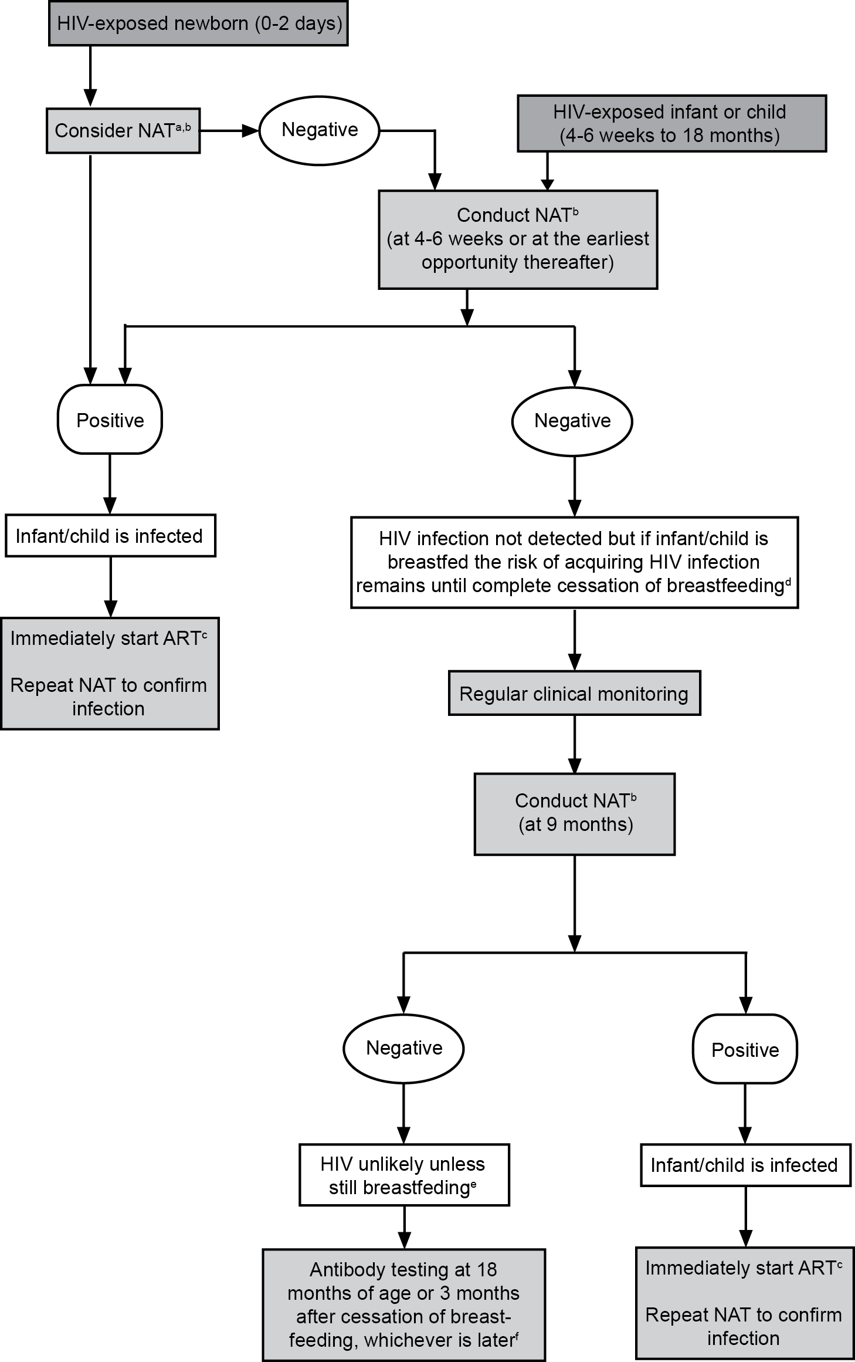
And let’s remember that Infant diagnosis is a process!
Moving to a multi-HIV NAT algorithm
Birth (where of value)
6 weeks
9 months
Any time HIV exposed infants present sick
Ensuring confirmatory testing of a positive NAT result is undertaken
Diagnosis is not completed without “final diagnosis” at the of the period at risk for transmission

Slide 14
Moving forward…
The WHO 2018 updated recommendation enable access to more potent regimens and promote actions to ensure more accurate infant diagnosis.
Tools and guidance have already been developed to support country adoption and adaptation of these guidelines
Dedicate efforts are being planned to actively assist priority countries in their efforts to implement these recommendations
WHO continues to work with global partners to promote a collaborative and coordinated agenda that ensure innovation and acceleration for an AIDS FREE generation

Slide 15
Acknowledgements
WHO colleagues
Meg Doherty
Lara Vojnov
Anisa Ghadrshenas
Serena Brusamento
Wole Ameyan
Systematic reviewers
Guidelines Development Group members
External Review Committee

